Slide 2


Welcome To:
Letterkenny
It is a free, one-day, hands-on training event led by Microsoft MVPs with support from Microsoft and local community leaders.
Developers worldwide are invited to attend the bootcamp to learn the latest on Microsoft /Azure AI Platform including Azure Bot Services, Azure Cognitive Services and Azure Machine Learning and apply what you learn to your future projects.
Letterkenny Microsoft User Group(LK-MUG) & Pramerica brings you this event in Letterkenny.

Slide 3





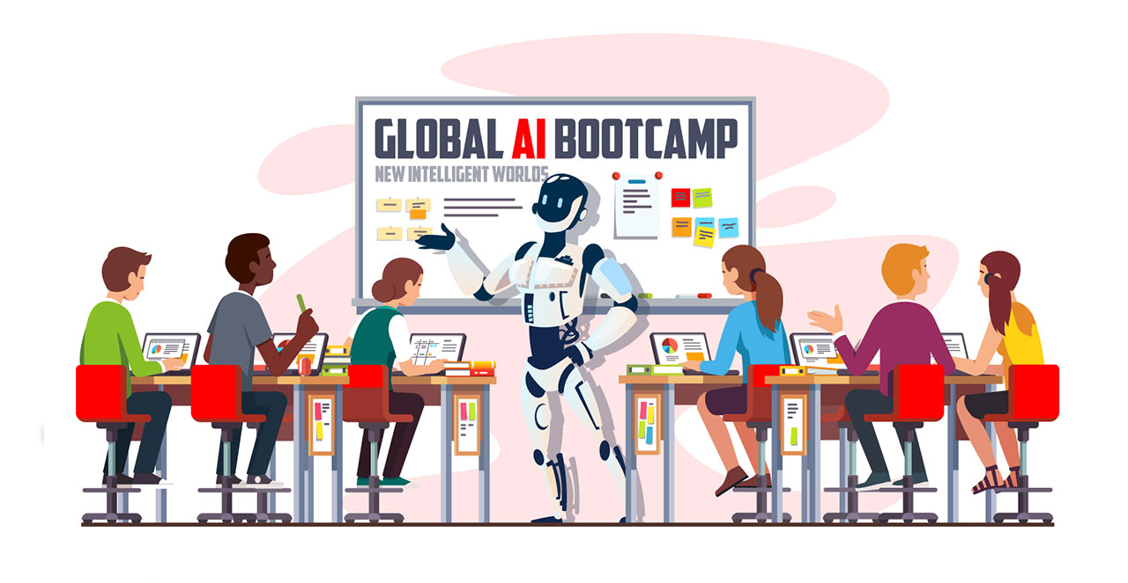





#GlobalAIBootcamp
#MVPBUZZ
#LKMUG
Hosted by
Letterkenny Dotnet
Azure UG
Sponsored by
Swags by
www.GlobalAIBootcamp.com
@Glob_AIBootcamp
www.BootcampLK.com
Venue:
Pramerica
Letterkenny Business & Technology Park
Letterkenny, Donegal, Ireland
Date:
Saturday, 15th Dec
Time:
9:00AM – 5:30PM
Sign Up Now!
https://bit.ly/2K6h7Nh

Slide 4
Conference Code of Conduct
Letterkenny
All attendees, speakers, sponsors and volunteers at our conference are required to agree with the following code of conduct. Organisers will enforce this code throughout the event. We expect cooperation from all participants to help ensure a safe environment for everybody.
Our conference is dedicated to providing a harassment-free conference experience for everyone, regardless of gender, gender identity and expression, age, sexual orientation, disability, physical appearance, body size, race, ethnicity, religion (or lack thereof), or technology choices.
We do not tolerate harassment of conference participants in any form. Sexual language and imagery is not appropriate for any conference venue, including talks, workshops, parties, Twitter and other online media.
Conference participants violating these rules may be sanctioned or expelled from the conference without a refund at the discretion of the conference organisers.
Need Help?
Write us on lk-mug@outlook.com or talk to one of the organizers Nithin/Velin

Slide 5
Letterkenny
Agenda:
Date: Saturday, 15th Dec Time: 9:00AM – 5:30PM
Time | Session | Speaker
9:00AM – 9:30AM | Registration & Networking Breakfast
9:30AM – 10:00AM | Keynote - The age of applied AI | Global HQ
10:00AM – 11:10AM | Session 1: Introduction to Azure Bot Service Principles of bot design, Design and control conversation flow Types of Bot Services Demos | Richard Fisher Solution Architect, Pramerica Owen Lyons Developer, Pramerica
11:00AM -- 11:15AM | Break
11:15AM – 12:15PM | Session 2: Introduction to Cognitive Services Vision, Knowledge, Language, Speech and Search. Demos Introduction to AI School | Nithin Mohan T K Senior Specialist, Pramerica Velin Georgiev Microsoft MVP, Tech Architect - Pramerica
12:15PM – 1:00 PM | Lunch Break + Networking
1:00PM – 2:00PM | Session 3: Introduction to Machine Learning and Azure Auto ML | Joon Du Rant Solution Architect, Pramerica
2:00PM – 3:30PM | Workshop – Hands On Labs
3:30PM - 3:45PM | Break
3:45PM – 5:00PM | Workshop Contd – Hands On Labs
5:00PM – 5:45PM | Q&A’s, Closing Note and Swag time | Richard Fisher
www.bootcamplk.com
#GlobalAIBootcamp

Slide 6

Connect
WiFi Access Point: Bootcamp
WiFi Password:
bootcamp

Slide 7

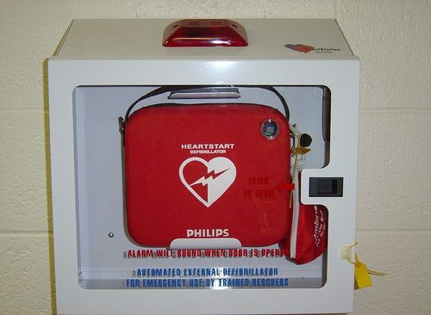

Emergency & Fire

Slide 8
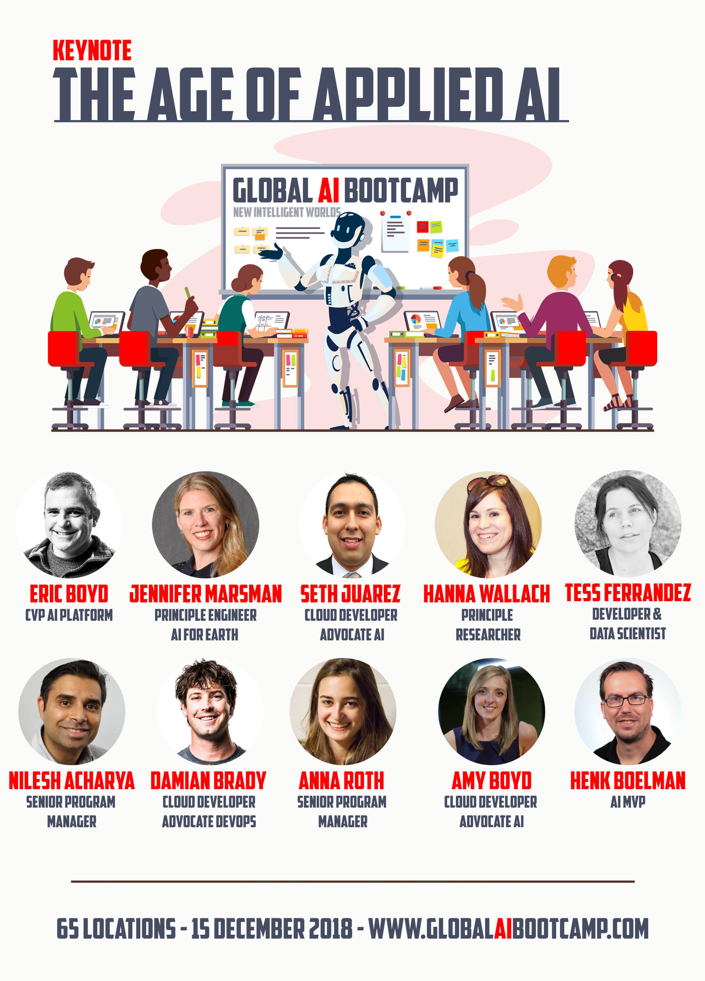
#GlobalAIBootcamp
#MVPBUZZ
#LKMUG
“ After a tremendous age of innovation and research in the AI field, we are moving towards the age of appliance.
But how and where do you get started as a developer and how do you apply machine learning ethically and use it for good.
In this keynote Amy and Henk asked eight Microsoft employees all with different backgrounds, their view on the topics: AI for developers, ethics in AI and AI for good. “

Slide 9
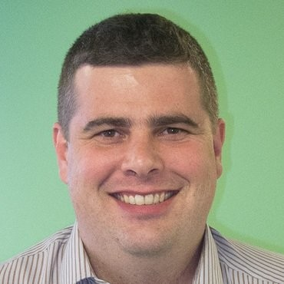
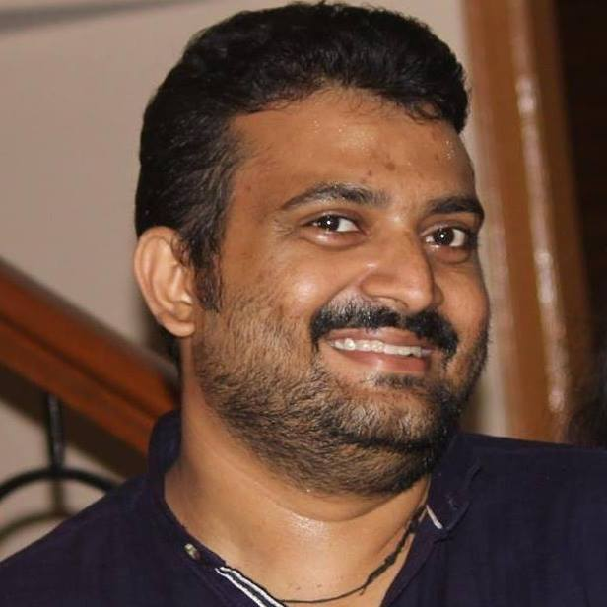
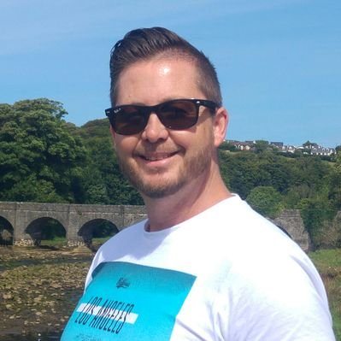
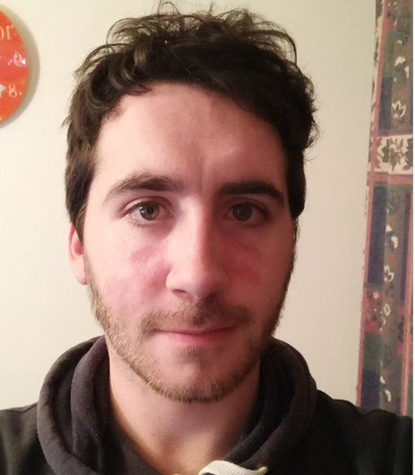
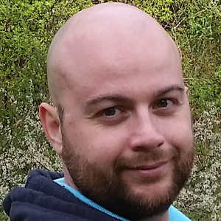
Welcome all Speakers
Letterkenny
Joon Du Rant
Nithin Mohan
Richard Fisher
Owen Lyons
Velin Georgiev

Slide 10
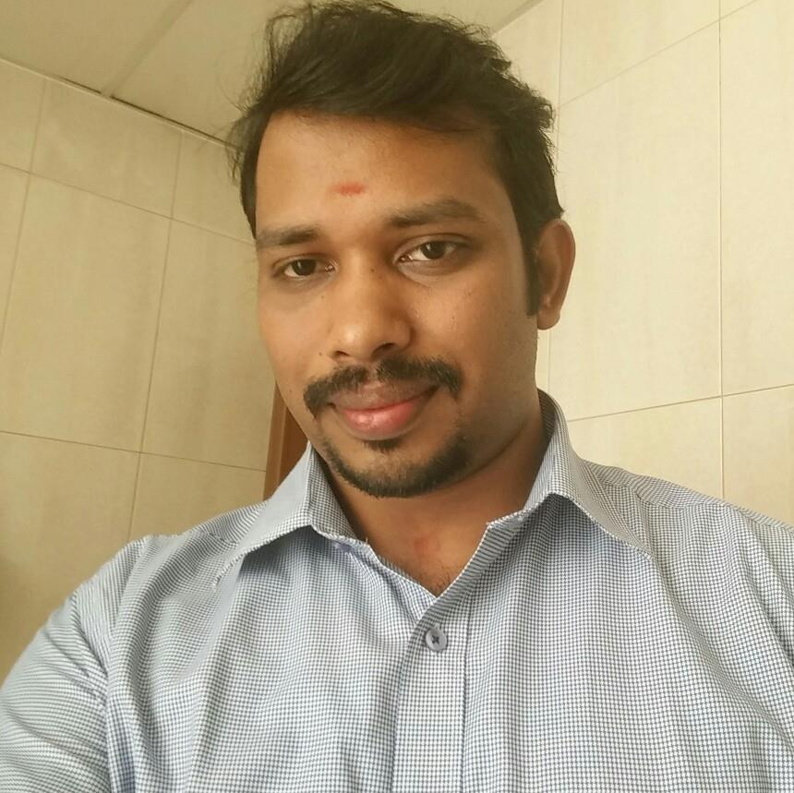
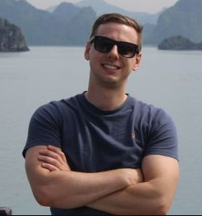
#LKMUG #CORE
LKMUG #Core #Team
Nithin Mohan
Sibin Sygal
Velin Georgiev
Joon Du Rant
Ray Hogan
Richard Fisher

Slide 11
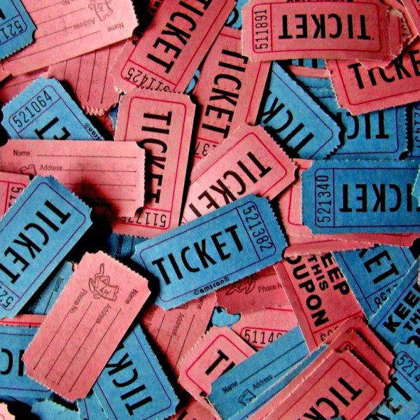



Letterkenny
Date: Saturday, 15th Dec Time: 9:00AM – 5:30PM
Sponsors:
Venue & Refreshments
RAFFLE for one, 1 year license
RAFFLE for one, 1 year license
Swags & Refreshments
Event theme, TShirts and lunch.

Slide 12
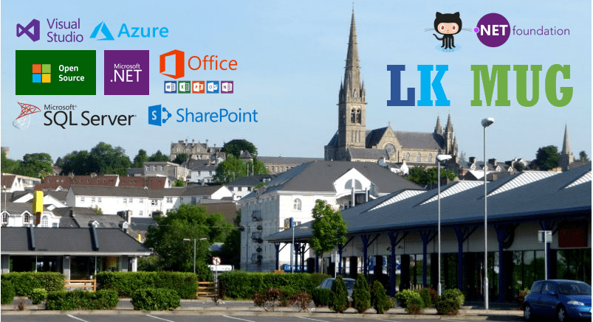
Join Us Website: http://www.lk-mug.org Meet up Url: https://www.meetup.com/lk-mug/ Twitter: https://www.twitter.com/lkmsug Facebook: https://www.facebook.com/lkmsug Hashtag: #lkmug

